Slide 1
Financial Markets
Learning Intention:
Explore the role and function of financial stock markets in the economy.
Success Criteria:
Explain the role and function of the financial and stock markets in the economy.
Do now:
Name the 2 people within the circular economy model, and name the 2 markets.
Challenge | Diagram of the circular economy

Slide 2
What do we mean?
When we think of ‘finance’, what pops in our head?
Learning intention | Explore the role and function of financial stock markets in the economy.
Success criteria | Explain the role and function of the financial and stock markets in the economy.

Slide 3
Learning intention | Explore the role and function of financial stock markets in the economy.
Success criteria | Explain the role and function of the financial and stock markets in the economy.

Slide 4
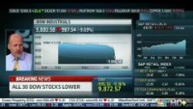
Learning intention | Explore the role and function of financial stock markets in the economy.
Success criteria | Explain the role and function of the financial and stock markets in the economy.

Slide 5

Learning intention | Explore the role and function of financial stock markets in the economy.
Success criteria | Explain the role and function of the financial and stock markets in the economy.

Slide 6
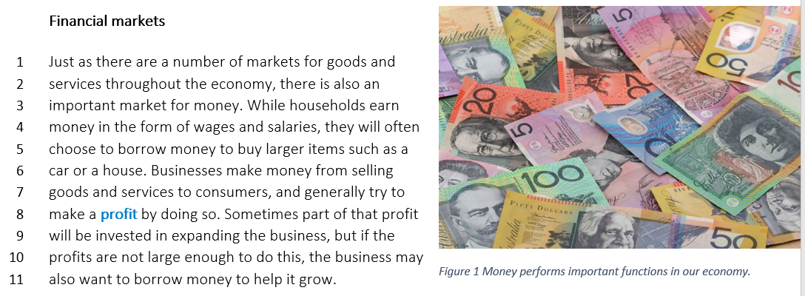
Learning intention | Explore the role and function of financial stock markets in the economy.
Success criteria | Explain the role and function of the financial and stock markets in the economy.

Slide 7
Check your understanding:
1. Explain what ‘profit’ is. What is it sometimes used to do?
Profit is when someone makes money, or equity on something that they bought for less. Eg, a house. People can take the extra money to invest in other things.
Learning intention | Explore the role and function of financial stock markets in the economy.
Success criteria | Explain the role and function of the financial and stock markets in the economy.

Slide 8
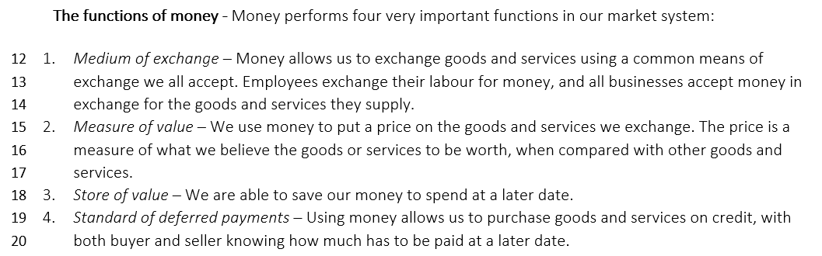
Learning intention | Explore the role and function of financial stock markets in the economy.
Success criteria | Explain the role and function of the financial and stock markets in the economy.

Slide 9
Check your understanding:
2. List the four functions of money:
Medium of exchange
Measure of value
Store of value
Standard of deferred payments
Learning intention | Explore the role and function of financial stock markets in the economy.
Success criteria | Explain the role and function of the financial and stock markets in the economy.

Slide 10
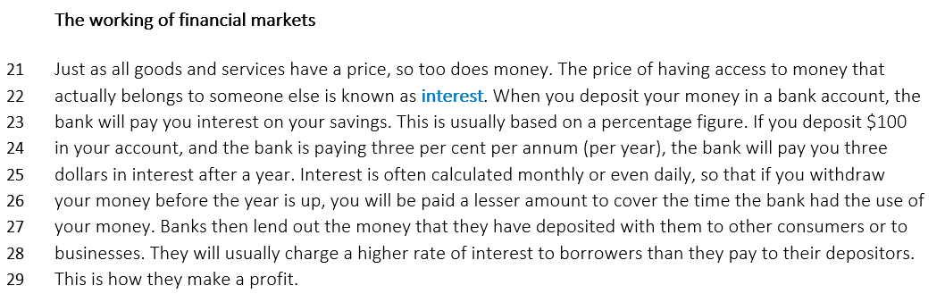
Learning intention | Explore the role and function of financial stock markets in the economy.
Success criteria | Explain the role and function of the financial and stock markets in the economy.

Slide 11
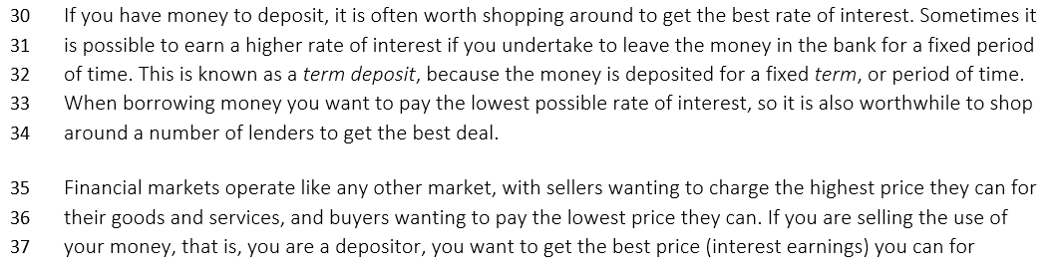
Learning intention | Explore the role and function of financial stock markets in the economy.
Success criteria | Explain the role and function of the financial and stock markets in the economy.

Slide 12
Check your understanding:
3. Describe what ‘interest’ is. How is it calculated?
Interest is the price of having access to money that belongs to someone else. It is calculated at a rate per annum (year)
Learning intention | Explore the role and function of financial stock markets in the economy.
Success criteria | Explain the role and function of the financial and stock markets in the economy.

Slide 13
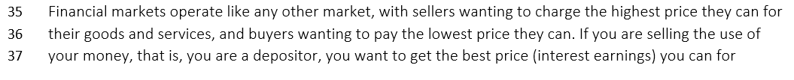
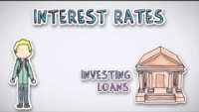
Learning intention | Explore the role and function of financial stock markets in the economy.
Success criteria | Explain the role and function of the financial and stock markets in the economy.

Slide 14
Check your understanding:
4. How do banks make a profit using interest?
Banks make profit using interest because people are charged interest on money they borrow. The banks then use this to lend more.
5. Explain ‘fixed term deposit’
Fixed term deposit means leaving your money in an account for a fixed amount of time in order to benefit from a better interest rate.
Learning intention | Explore the role and function of financial stock markets in the economy.
Success criteria | Explain the role and function of the financial and stock markets in the economy.

Slide 15
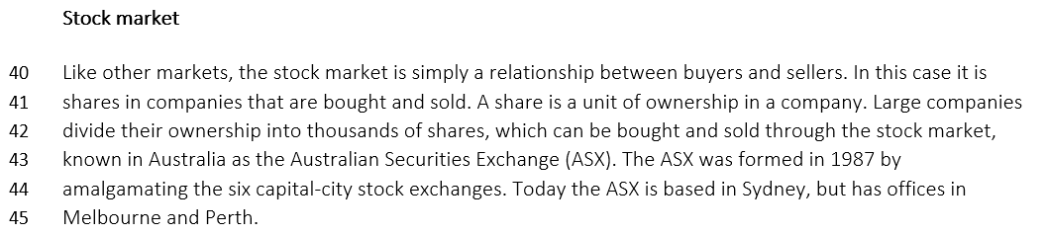
Learning intention | Explore the role and function of financial stock markets in the economy.
Success criteria | Explain the role and function of the financial and stock markets in the economy.

Slide 16
Check your understanding:
6. What is a share?
A share is a unit of ownership in a company.
7. What is the ASX?
Australian Securities Exchange – it is a stock market where people can buy and sell shares in companies.
8. When did the ASX form?
1987
Learning intention | Explore the role and function of financial stock markets in the economy.
Success criteria | Explain the role and function of the financial and stock markets in the economy.

Slide 17
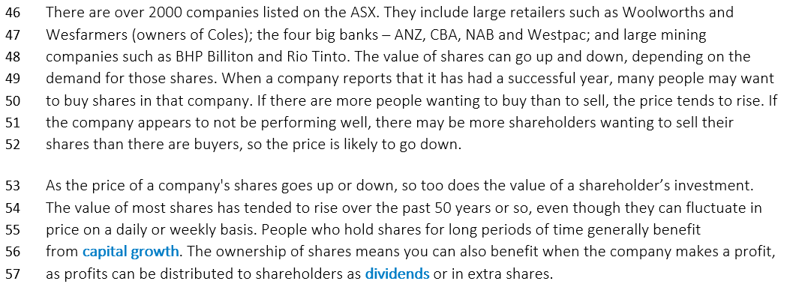
Learning intention | Explore the role and function of financial stock markets in the economy.
Success criteria | Explain the role and function of the financial and stock markets in the economy.

Slide 18
Check your understanding:
9. List some of the large companies on the ASX
Woolies, Coles, ANZ, NAB, Westpac
10. What events cause prices of shares to rise?
A successful year for profits or sales.
Learning intention | Explore the role and function of financial stock markets in the economy.
Success criteria | Explain the role and function of the financial and stock markets in the economy.

Slide 19
Check your understanding:
11. Explain what dividends are
Profits from the company that are distributed among shareholders. The more shares you have, the more dividends you will receive.
Learning intention | Explore the role and function of financial stock markets in the economy.
Success criteria | Explain the role and function of the financial and stock markets in the economy.

Slide 20
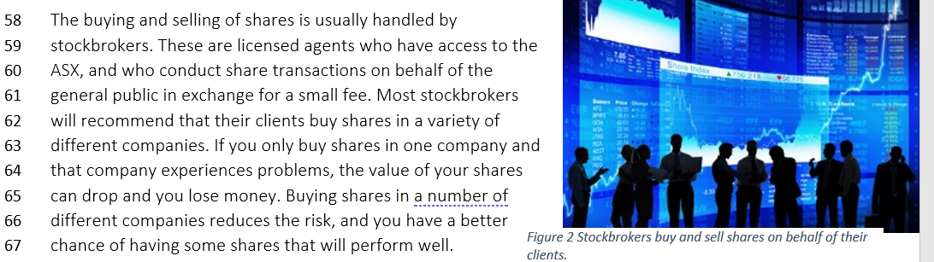
Learning intention | Explore the role and function of financial stock markets in the economy.
Success criteria | Explain the role and function of the financial and stock markets in the economy.

Slide 21
Check your understanding:
12. Who are stockbrokers? What do they do?
Licensed agents who have access to the ASX, they receive a small fee for their expertise.
13. How can people reduce the risks when buying shares?
Buying a variety of shares in different companies
Learning intention | Explore the role and function of financial stock markets in the economy.
Success criteria | Explain the role and function of the financial and stock markets in the economy.

